Slide 1

Final Group Project – BDAT 1004 Data Programming
Group -6 – Jaivardhan Singh | Muzammil Abbas Anajwala | Barkha Maheshbhai Patel

Slide 2
Project Summary
This project will demonstrate the use of Web Application and other important aspects of high level python programming, data analysis tools, charting techniques, and use of frameworks like Django along with the implementation of API and Cloud Database.
This project has entirely done under the group and no data has been transferred to any other third party.
The dataset chosen in this program is from the following source - https://data.world/rajanand/suicides-in-india
Different tools and programming languages are used to fetch the data from the website and add to the cloud

Slide 3
Project Summary
The first task that has been done in the project is to automatically take the data from the given URL.
The characteristics of the dataset are as follows
This dataset contains yearly suicide details of all states/u.t of India by various parameters from 2001-2012.The parameters are as follows:-
Gender - Sex of the person
Age Group – from 0 to 100
Total - Count
Type Code - It mainly shows the status which is categorized as Social, Educational, Professional, Social.
Type - It further categorize the Type code that is the causes

Slide 4
Project Summary
This dataset contains total of 23517 rows excluding headings.
Details of Data type:-
a. State – varchar
b. Year – date (initially was varchar, when cleaned, converted to date)
c. Type_code – varchar
d. Gender – varchar
e. Type – varchar
f. Age_group – int
g. Total – int (initially was varchar, when cleaned, converted to int)
The dataset had no null values.

Slide 5


Tools & Languages Used
1. JavaScript :-
JavaScript, often abbreviated as JS, is a programming language that conforms to the ECMAScript specification. JavaScript is high-level, often just-in-time compiled, and multi-paradigm. It has curly-bracket syntax, dynamic typing, prototype-based object-orientation, and first-class functions.
2. Python :-
Python is a programming language with essential libraries and packages for data science, including Pandas and NumPy. In the analysis process, we will use Python for web scraping from Twitter. We have selected Python because it is universally accepted for data analytics with ample documentation to support any issues.

Slide 6


Tools & Languages Used
4. Django:-
Django is a high-level Python web framework that encourages rapid development and clean, pragmatic design. Built by experienced developers, it takes care of much of the hassle of web development, so you can focus on writing your app without needing to reinvent the wheel. It’s free and open source.2. Python :-
5. Google Cloud Platform:-
Google Cloud Platform (GCP), offered by Google, is a suite of cloud computing services that runs on the same infrastructure that Google uses internally for its end-user products, such as Google Search, Gmail, file storage, and YouTube. Alongside a set of management tools, it provides a series of modular cloud services including computing, data storage, data analytics and machine learning.

Slide 7


Tools & Languages Used
4. Google Cloud SQL:-
Cloud SQL provides a cloud-based alternative to local MySQL, PostgreSQL, and SQL Server databases. Cloud SQL also lets you create and delete databases and database users, but it isn't a database administration tool. There are many database administration tools you can choose from, depending on your database engine.
5. Google Charts:-
Google Charts is an interactive Web service that creates graphical charts from user-supplied information. The user supplies data and a formatting specification expressed in JavaScript embedded in a Web page; in response the service sends an image of the chart.

Slide 8
Team Information
Member – 1 - Jaivardhan Singh
Roles & Responsibilities :- Project Manager & Business Analyst - Manage the deliverables of the project, works with Business Analyst to build the documentation for proposal.
Member – 2 - Muzammil Abbas Anajwala
Roles & Responsibilities :- Develop the software front and back end
Member -3 - Barkha Maheshbhai Patel
Roles & Responsibilities :- Acquire data, build data models and database if needed

Slide 9
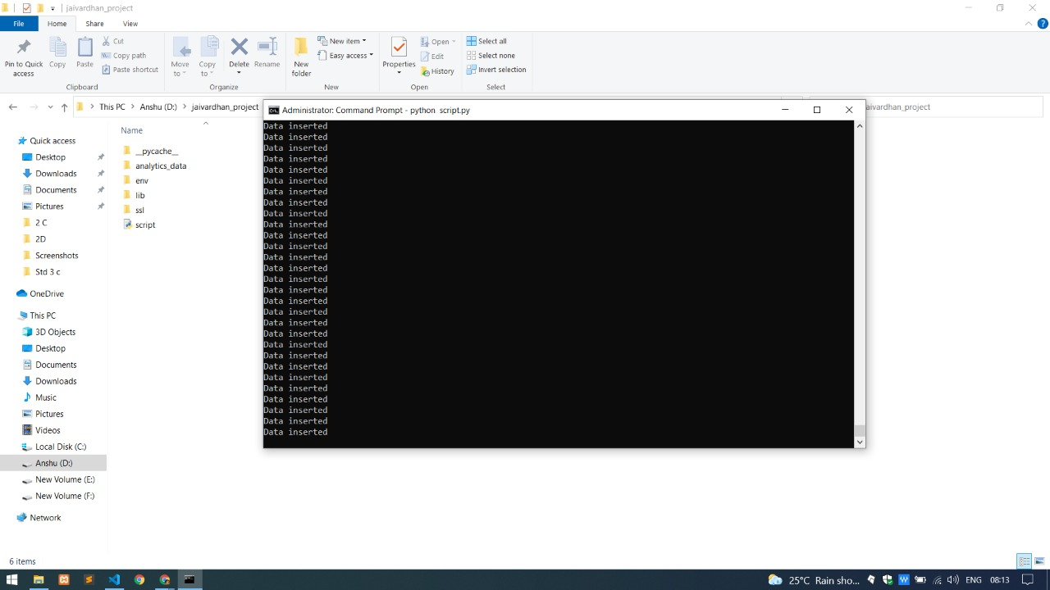
Process Functioning
Fetching Data from the URL. All the coding has been done in python in back-end.
Use of data.world library in the python to fetch the data from the URL and stored it into an array and entered the Database, if the data is not available it will insert automatically.

Slide 10
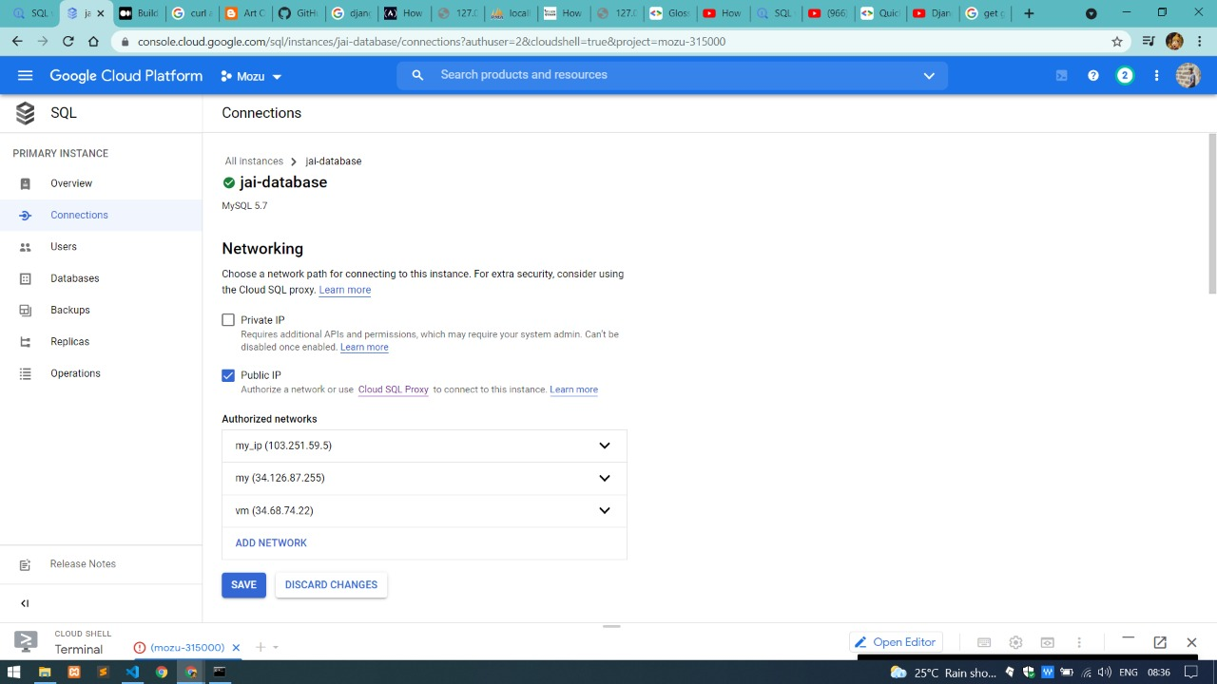
Process Functioning
Creating a database in Google Cloud Platform and assignment public network authorization for API programming
Data has been successfully transferred to a place in cloud storage and has been set for further manipulation.

Slide 11
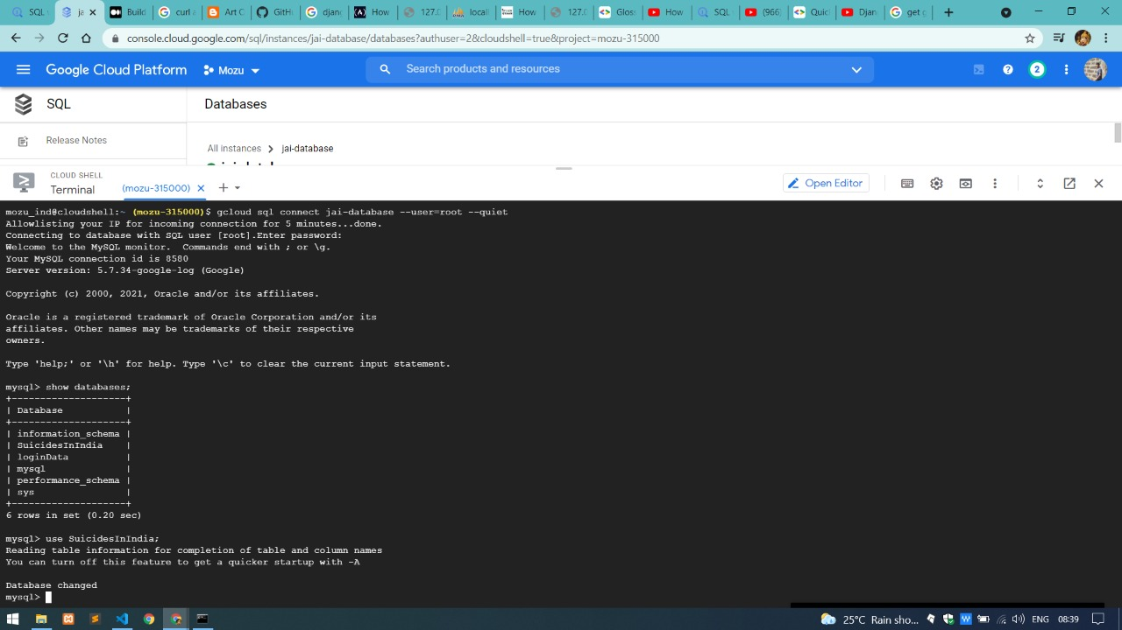
Process Functioning
Using CloudSQL, data has been processed and we have tried to run queries to find the knowledge about data
Questions that the team thought would be okay to answered were fetched through different SQL queries.

Slide 12
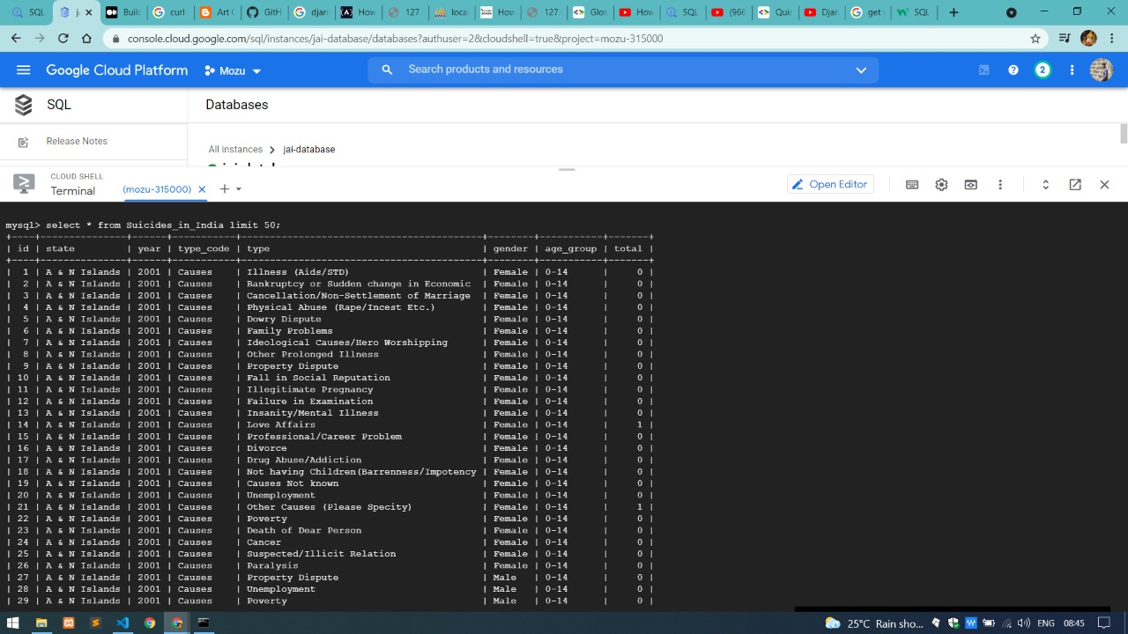
Process Functioning
Using Python, a pseudo-batch process has been created to sync with data every 24-hour.
Several kinds of data requires query to be fetched every minutes and seconds, making the process lengthy

Slide 13
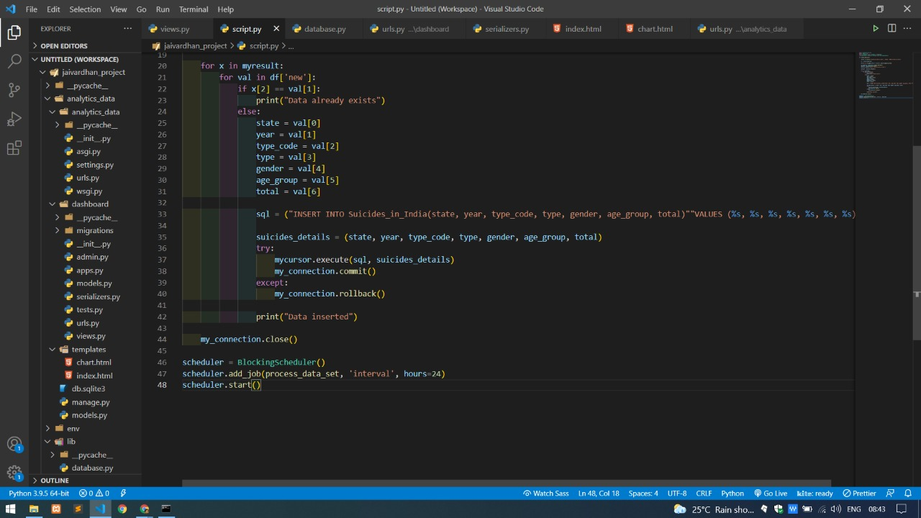
Process Functioning
After 24-hour Process of synchronizing
Several kinds of data requires query to be fetched every minutes and seconds, making the process lengthy

Slide 14
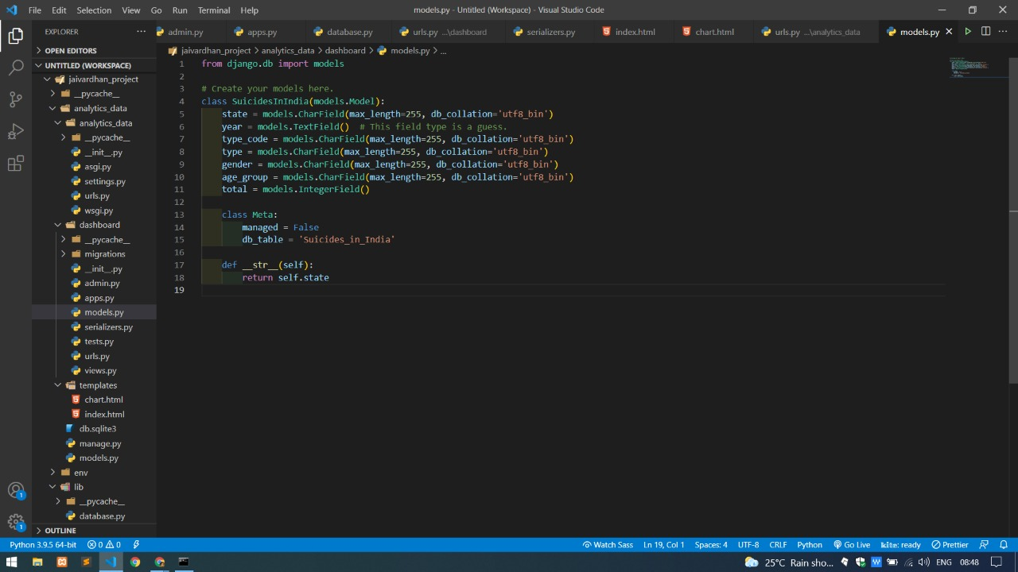
Process Functioning
Using Django, every ounce of data has been reflecting to the framework application
Django has back-end python programming, which makes the continuous deployment of the project easy and understandable.

Slide 15
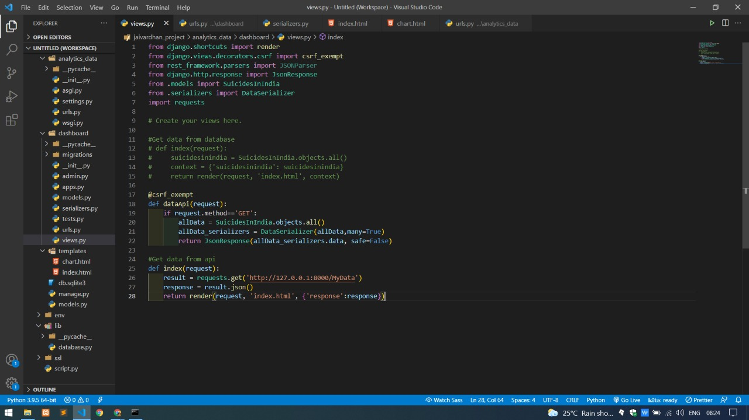
Process Functioning
Created an API, which served the purpose of syncing with the data
API has its advantage of being highly secured in terms of transferring data from one place to another.

Slide 16
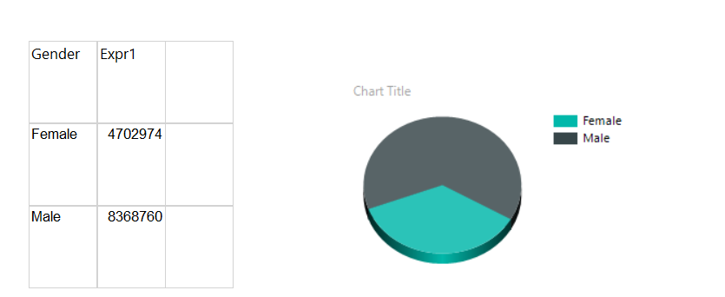
Results
First Analysis of question. Gender wise total cases

Slide 17
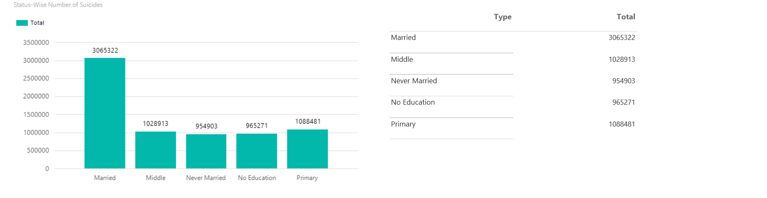
Results
Second Analysis of question. Category wise total cases

Slide 18
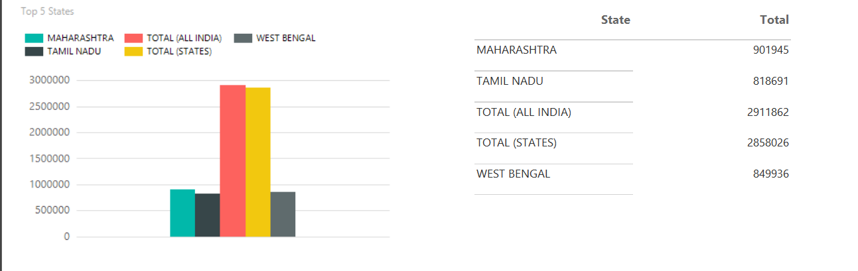
Results
Third Analysis of question. State wise total cases

Slide 19
Fit-Gap Analysis
Created by - Business Analyst
Reviewed by - Project Manager
Determining the feasibility of requirements. (Feature List)
The requirements of this project is as follows-
a. The acquisition of a data source from a remote source (URL) (M4)
b. Acquire data and store into a cloud database. (M4)
c. Run a pseudo-batch process that runs every 24-hours to acquire data and store in this database. (M4)
d. Portraying the results into website using web application framework. (M4)
e. Creating charts using different charting techniques into the dashboard. (M4)
f. API that serves from LIVE database. (S3)
Notes:
M(4) - Must have to meet the business needs.
S(3) - Should have, but project success does not rely on it.
C(2) - Could have if it does not affect anything else on the project.
W(1) - Would like to have later, but delivery won't be this time.

Slide 20
Fit-Gap Analysis
Evaluating existing first-party apps for use.
All the tools and technology along with programming languages used in this project has been mentioned from slide 5-7. Please refer to them.
Gap List –
a. Dashboard techniques (M4)
b. API fetching data (C2)
GAP Score:-
Average scores from requirements – Average scores from gaps¹
Score :- 3.83 – 3 = 0.83
Notes:
1. Here, Average of all the scores from requirements has been taken and subtracted from gap.

Slide 21
Thank you!!! Questions?

